Slide 1

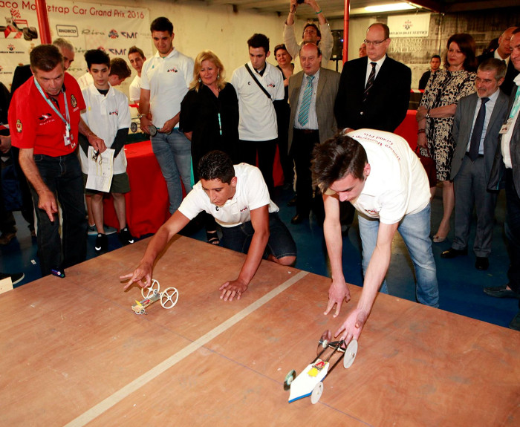
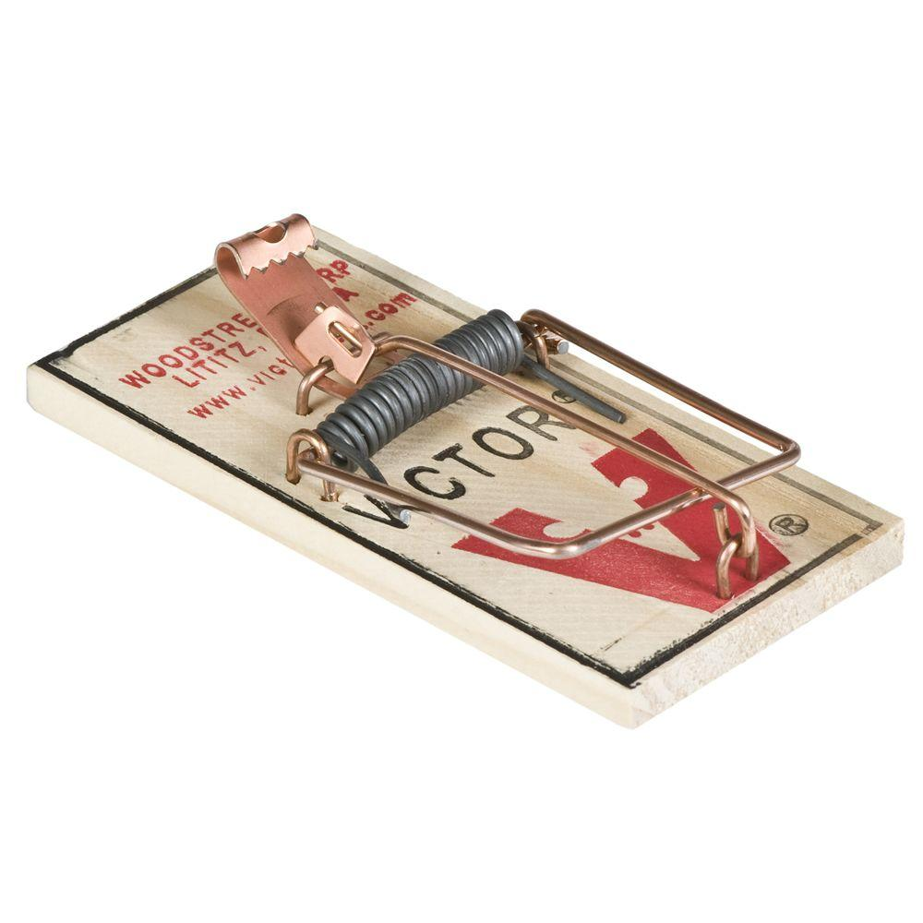
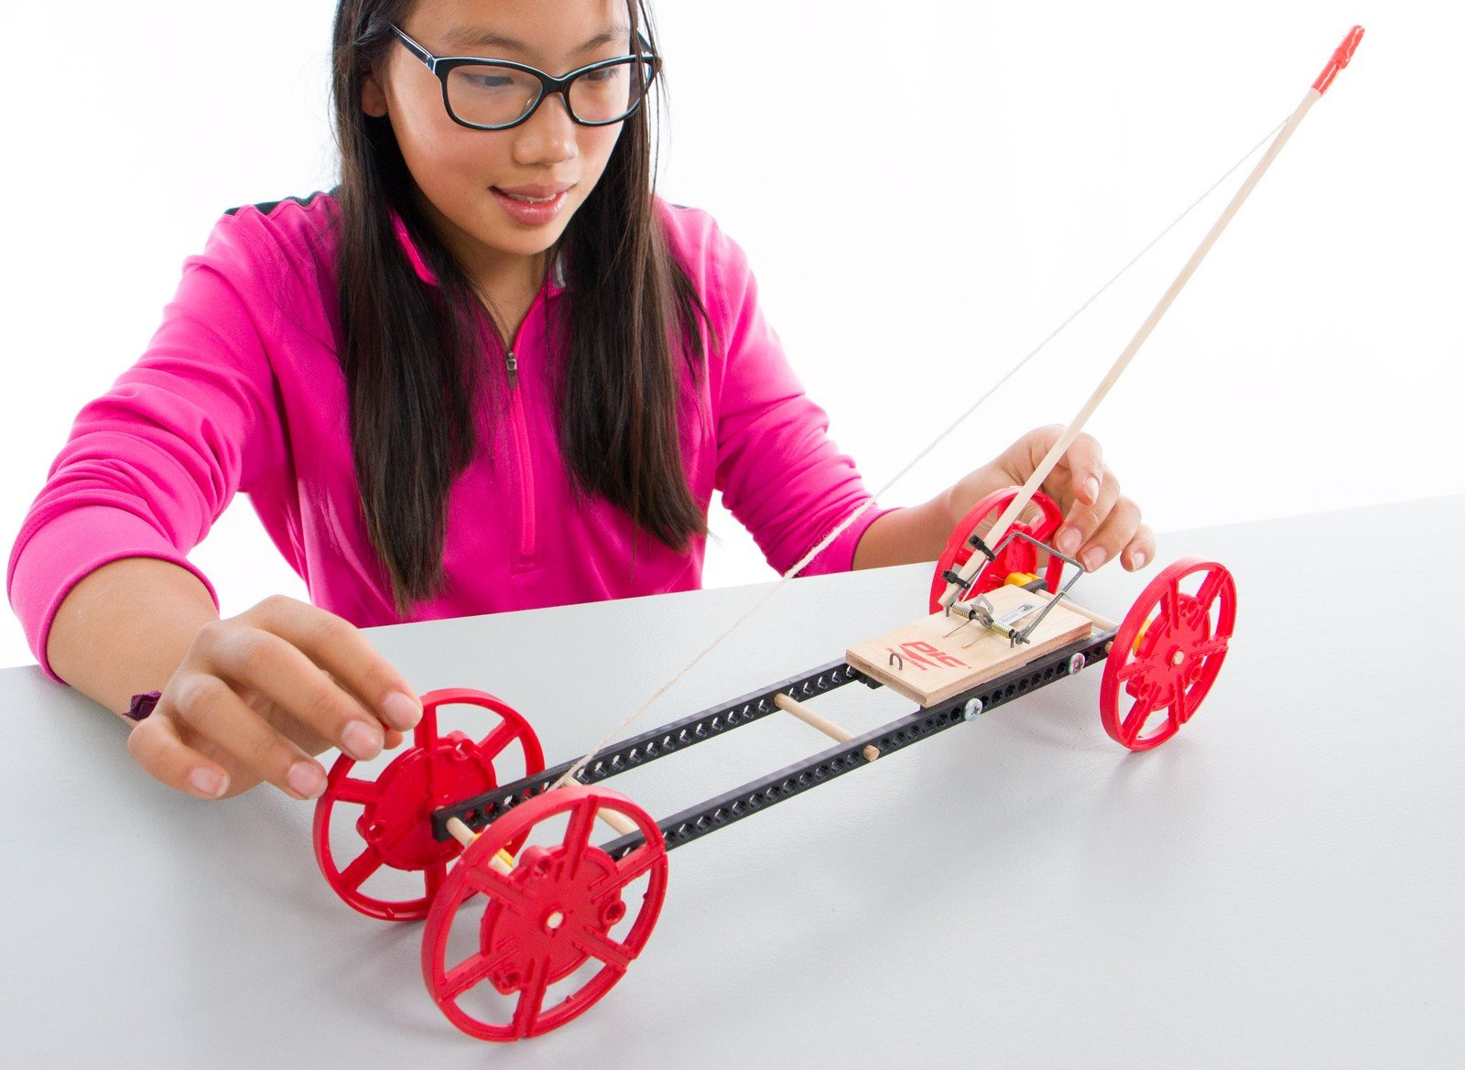
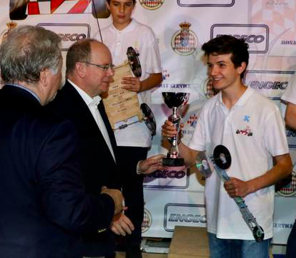
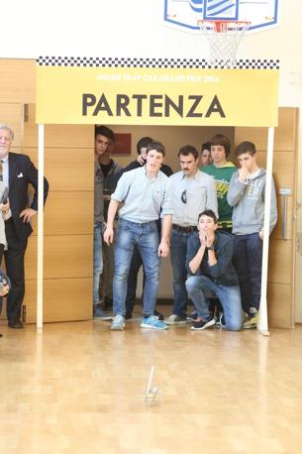
SIGN UP & RECEIVE THE MOUSETRAP
BUILD YOUR VEHICLE
RACE IN YOUR SCHOOL
THE BEST PROJECTS ARE SELECTED FOR THE GRAND FINAL
1
2
3
4
COME TO MONACO!
SHOW YOUR PROJECT TO THE HIGHEST AUTHORITIES
MEET THE FORMULA ONE PILOTS
WATCH THE GRAND PRIX FROM A PRIME LOCATION
5

